Slide 1
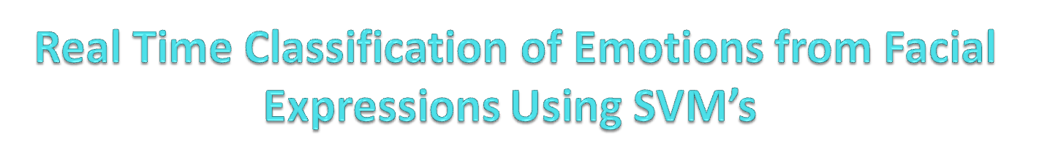

Presented By :-
Manjot Singh Bilkhu (20135100)
Shashank Bharadwaj (20135032)
Shailendra Azad (20135159)
Guided By :-
Prof. V.K.Srivastava
Department Of Electronics And Communication Engineering
Motilal Nehru National Institute Of Technology Allahabad
Allahabad, U.P

Slide 2
Presentation Outline
Motivation
Desired functionality
Face Detection
Facial Keypoints Detection
Classification
Future Prospects

Slide 3
Motivation
HCI
  Machines can be automated to perform various actions based on Micro-expressions
  According to some estimates, the facial expression of the speaker counts for 55% of the effect of the spoken message (with the voice intonation contributing 38%, and the verbal part just 7%)
Behavioral science research
  Automation of objective measurement of facial activity
  In Medical Science to monitor Patient Behaviour

Slide 4
Desired Functionality & Objectives
Human visual system = good reference point
Desired properties:
  Works on images of people of any sex, age, and ethnicity
  Robust to variation in lighting
  Insensitive to hair style changes, presence of glasses, facial hair, partial occlusions
  Can deal with rigid head motions
  Is real-time
  Capable of classifying expressions into multiple emotion categories
  Able to learn the range of emotional expression by a particular person

Slide 5
Methodology
Face Detection
Detecting Facial Landmarks
Training Model
Classification Using SVM

Slide 6
The Viola/Jones Face Detector
A seminal approach to real-time object detection
Training is slow, but detection is very fast
Key ideas
  Integral images for fast feature evaluation
  Boosting for feature selection
  Attentional cascade for fast rejection of non-face windows

Slide 7
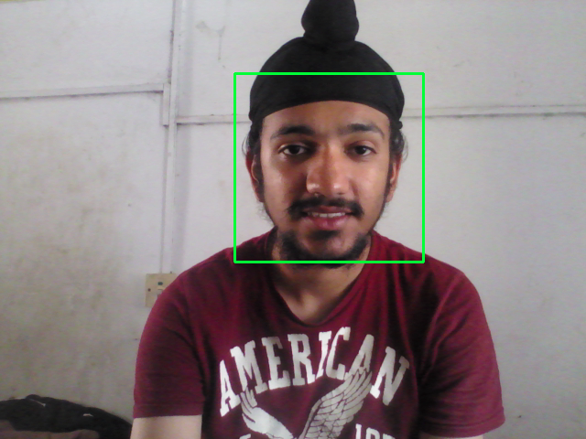
Simulation

Slide 8
Cascaded Classifiers
We start with simple classifiers which reject many of the negative sub-windows while detecting almost all positive sub-windows
Positive response from the first classifier triggers the evaluation of a second (more complex) classifier, and so on
A negative outcome at any point leads to the immediate rejection of the sub-window
T
T
T
IMAGE
SUB-WINDOW
T
FACE
Classifier 1
Classifier 2
Classifier 3
F
F
F
NON-FACE
NON-FACE
NON-FACE

Slide 9
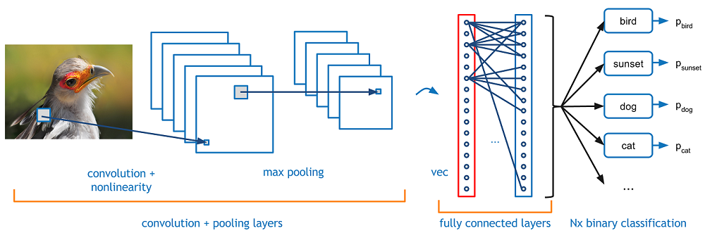
Facial Keypoints Detection
To incorporate Pose and Rotational Invariance
Detects some “Key Points” on each detected face
Implemented using a CNN Architecture
Keypoints are chosen using Convolution
Max Pooling and Dropout Layers are used for dimensionality Reduction
Output Layer: Softmax Classifier that has 68 outputs
Each output node represents a facial landmark

Slide 10
Convolutions
Typical MLPs have a connection from every node in the previous layer, and the net value for a node is the scalar dot product of the inputs and weights (e.g. matrix multiply). Convolutional nets are somewhat different:
  Nodes still do a scalar dot product (convolution) from the previous layer, but with only a small portion (receptive field) of the nodes in the previous layer – Sparse representation
  Every node has the exact same weight values from the preceding layer – Shared parameters, tied weights, a LOT less unique weight values. Regularization by having same weights looking at more input situations
  Each node has it’s shared weight convolution computed on a receptive field slightly shifted, from that of it’s neighbor, in the previous layer – Translation invariance.
  Each node’s convolution scalar is then passed through a non-linear activation function (ReLU, tanh, etc.)
CS 678 – Deep Learning

Slide 11
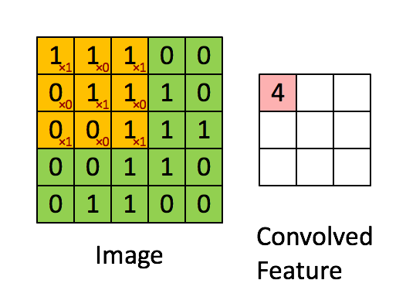
Convolution Example

Slide 12
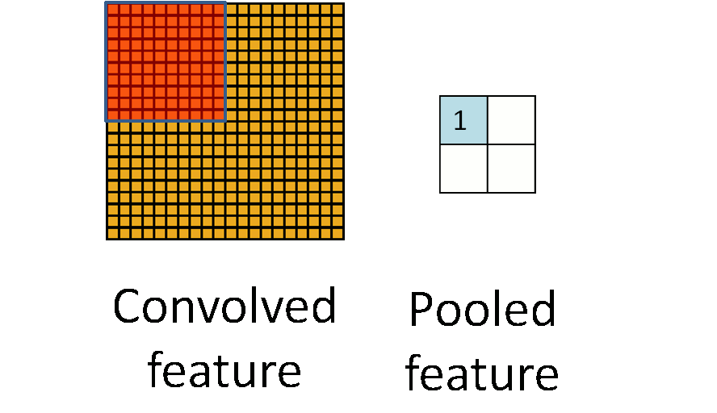
Pooling Example (Summing or averaging)

Slide 13

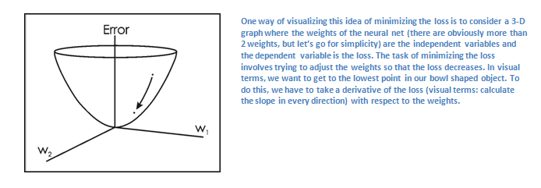

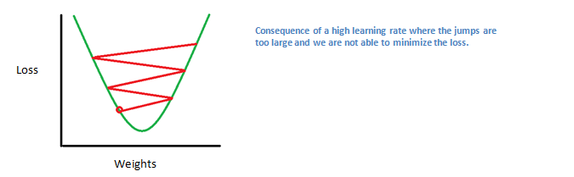
Backpropagation (Training)
Backpropagation can be separated into 4 distinct sections, the forward pass, the loss function, the backward pass, and the weight update

Slide 14
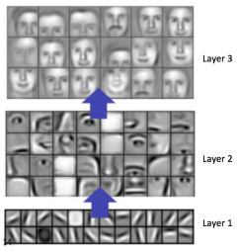
Visualizing the Architecture

Slide 15
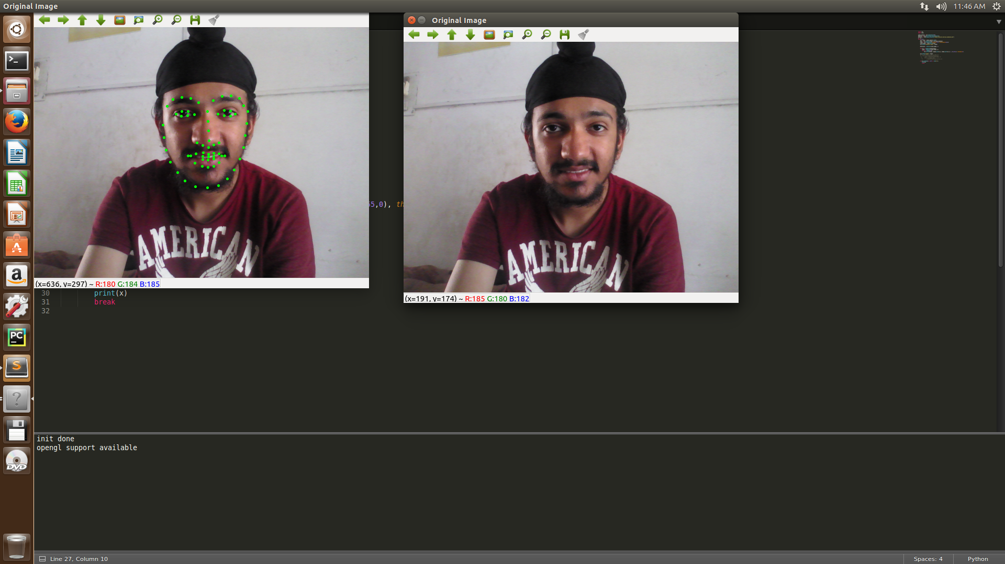
Facial Keypoints Detection

Slide 16
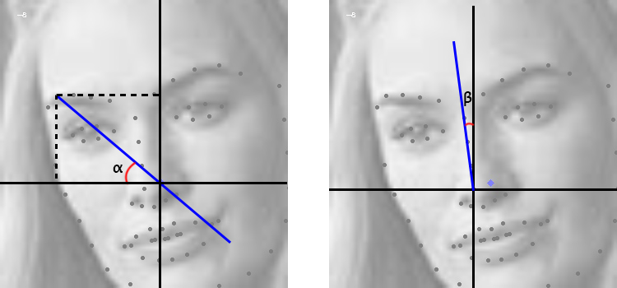
Feature Extraction
Compute Angles of all Keypoints
Incorporate for Offset
Store all computed angles as a vector
These are “Features” that we use to train/test

Slide 17
Training Data (What the Machine Sees)
18 3 -14 -31 -46 -59 -72 94 81 68 55 40 22 5 -13 -28 47 56 64 72 81 -76 -67 -59 -50 -42 92 93 93 -82 2 -13 84 24 2 46 55 65 68 56 47 -64 -59 -50 -40 -42 -51 -57 -47 -61 92 72 56 66 76 88 94 -78 -67 -61 -71 93 81 71 86 94 -77
Label for the above set of features: Happy
104 90 75 58 43 28 13 179 165 150 133 117 101 87 73 61 128 137 147 155 165 9 19 30 39 49 175 173 166 80 65 42 11 151 117 128 137 145 149 138 129 24 30 38 47 45 37 38 31 19 2 166 150 141 157 169 1 12 24 33 16 2 166 146 166 2 15
Label for the above set of features: Neutral

Slide 18
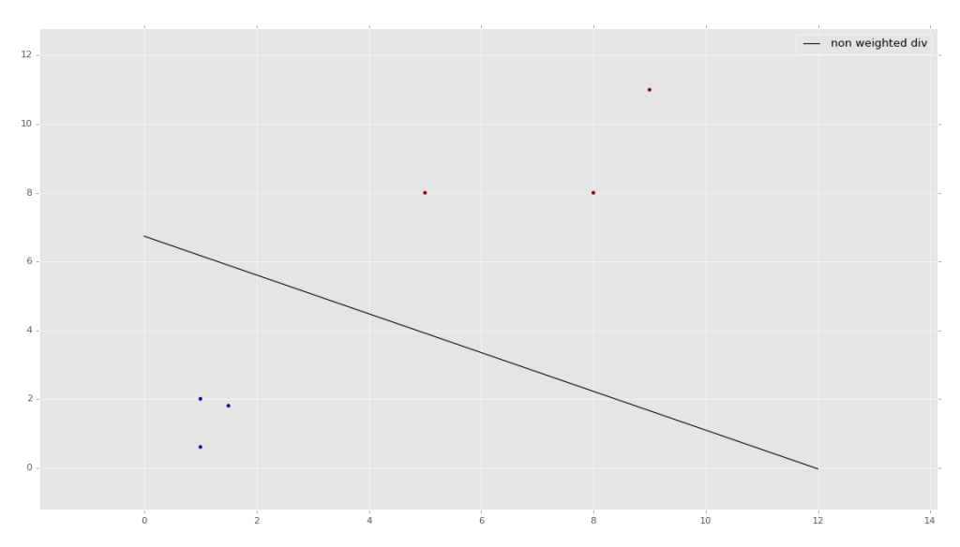
Support Vector Machines
Popular Machine Learning Algorithm
Used to Classify Data into different classes
Model is trained using a Comprehensive Dataset

Slide 19
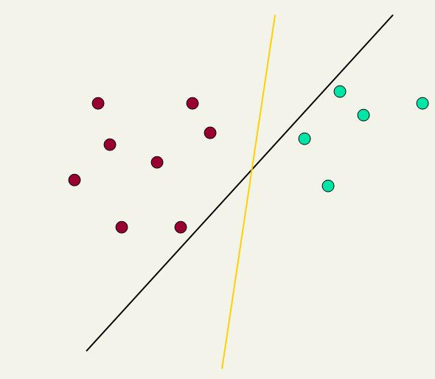
Linear classifiers: Which Hyperplane?
Ch. 15
Lots of possible solutions for a, b, c.
Some methods find a separating hyperplane, but not the optimal one [according to some criterion of expected goodness]
  E.g., perceptron
Support Vector Machine (SVM) finds an optimal* solution.
  Maximizes the distance between the hyperplane and the “difficult points” close to decision boundary
  One intuition: if there are no points near the decision surface, then there are no very uncertain classification decisions
This line represents the decision boundary:
ax + by − c = 0

Slide 20
Support Vector Machine (SVM)
Sec. 15.1
SVMs maximize the margin around the separating hyperplane.
    A.k.a. large margin classifiers
The decision function is fully specified by a subset of training samples, the support vectors.
Solving SVMs is a quadratic programming problem
Seen by many as the most successful current text classification method*
Support vectors
Maximizes
margin
Narrower
margin
*but other discriminative methods often perform very similarly

Slide 21
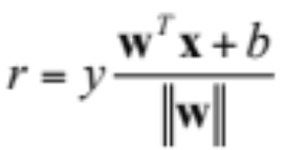
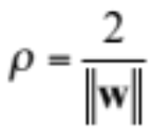
Linear SVM Mathematically
The linearly separable case
Sec. 15.1
Assume that all data is at least distance 1 from the hyperplane, then the following two constraints follow for a training set {(x_{i} ,y_{i})}
For support vectors, the inequality becomes an equality
Then, since each example’s distance from the hyperplane is
The margin is:
w^{T}x_{i} + b ≥ 1 if y_{i} = 1
w^{T}x_{i} + b ≤ −1 if y_{i} = −1

Slide 22
Linear SVMs Mathematically (cont.)
Sec. 15.1
Then we can formulate the quadratic optimization problem:
A better formulation (min ||w|| = max 1/ ||w|| ):
Find w and b such that
is maximized; and for all {(x_{i} , y_{i})}
w^{T}x_{i} + b ≥ 1 if y_{i}=1; w^{T}x_{i} + b ≤ -1 if y_{i} = -1
Find w and b such that
Φ(w) =½ w^{T}w is minimized;
and for all {(x_{i} ,y_{i})}: y_{i} (w^{T}x_{i} + b) ≥ 1

Slide 23
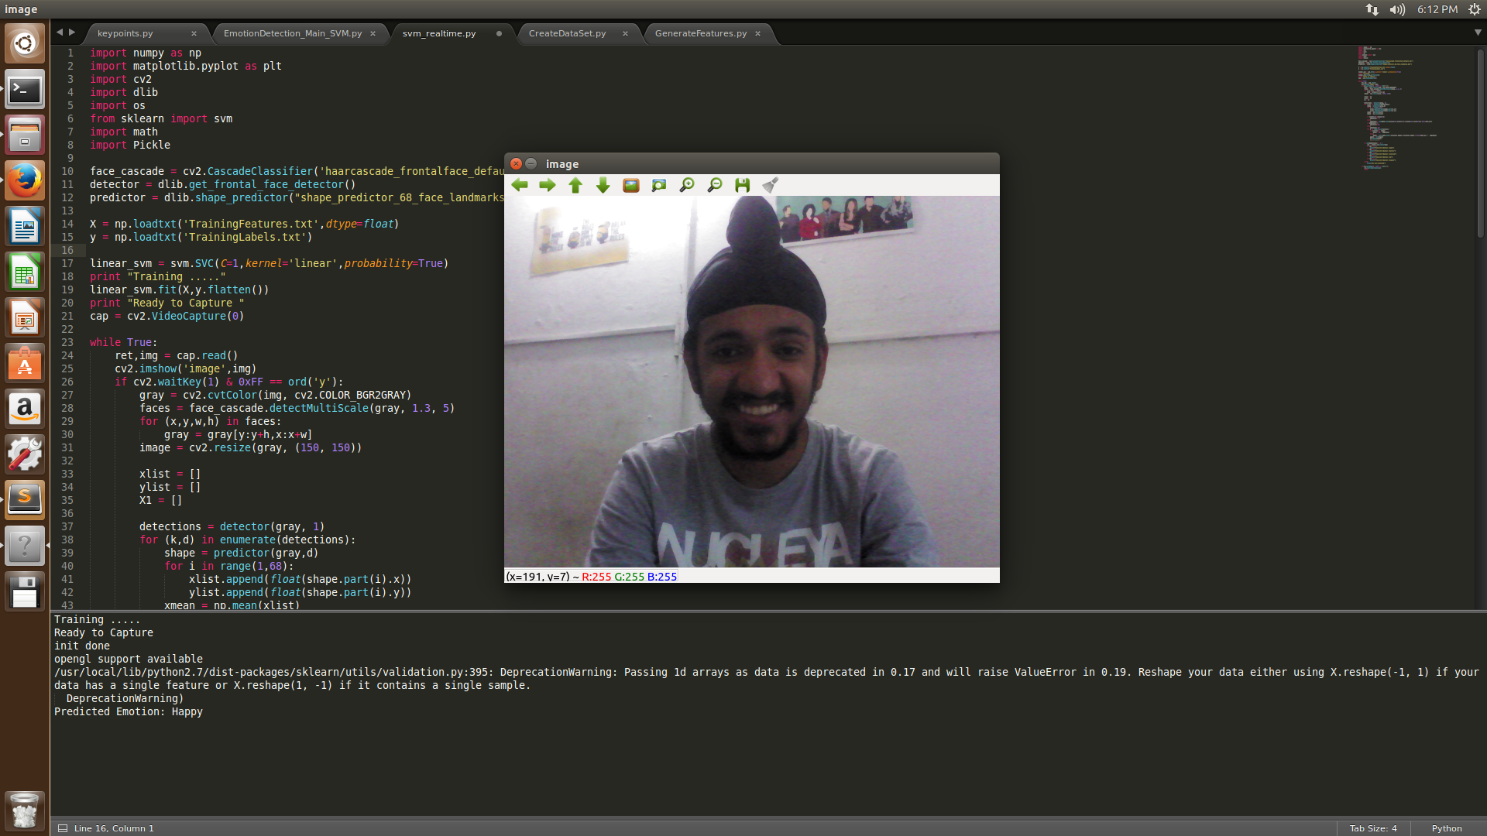
Results (Classified as Happy)

Slide 24
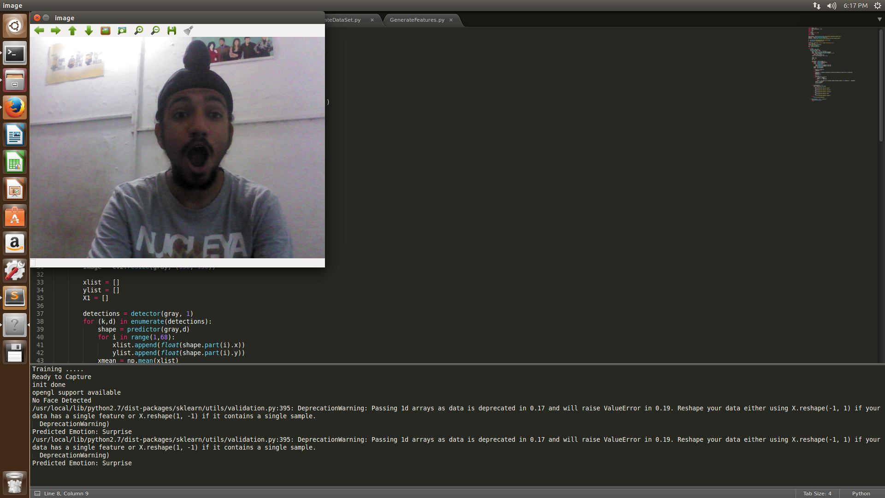
Results (Classified as Surprised)

Slide 25
Tools Used
Linux Ubuntu 16.04
Python 2.7
OpenCV 3.1
Scikit-learn (ML Library)
Tensorflow
Keras

Slide 26
Thank You

